Slide 1
How to Install Chemkin Pro Student
Prof. Green 5.68J/10.652J
Sept 01 2020
Charles McGill

Slide 2
Chemkin Pro Student Version
Ansys Student 2020 R2
Windows only
Free download
Local license – no connection to outside server
Roughly 25 GB install, 60 GB if you install a virtual machine for it
Many bundled applications, some of which can be deleted afterwards for disk space

Slide 3
Windows Virtual Machine
If you are using a non-Windows system, MIT has made available virtual machine image for windows that will allow you access.
VmWare – runs virtual machines
https://ist.mit.edu/vmware-fusion
Vmware Fusion Pro for Macs
Vmware Workstation Pro for Linux
Linux install from the download with command “sudo sh <insert_the_bundle_filename>.bundle”
Windows 10 Virtual Machine
https://ist.mit.edu/windows/10/base-vm Basic installation option, 9 GB zip
https://ist.mit.edu/windows/10/student-vm Some extra software, 12 GB zip
Save and extract in the directory that you want to be the working directory for vmware.
Default 60 GB disk space allocation, enough to install Ansys Student.
Updated every semester, switch to the newest one if you have one already.
Old VMs can accumulate update files and crowd out disk space.

Slide 4
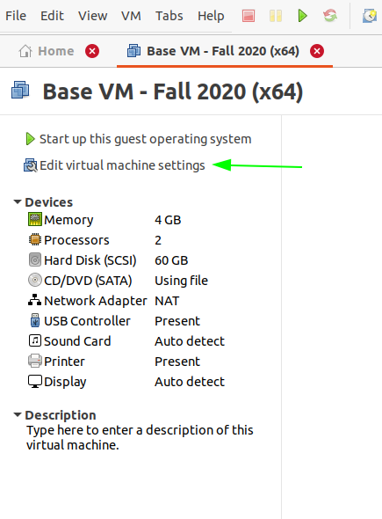
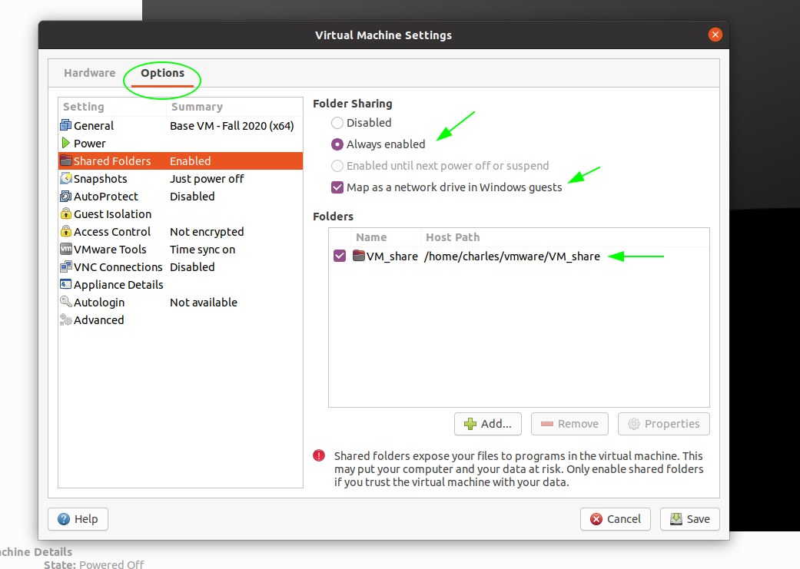
VMware
For Linux, launch from terminal as root (sudo vmware) to make sure settings are saved between sessions.
Open the .vmx file for your downloaded and extracted Windows virtual machine to load it into vmware.
On first launch, you will need to set up your username, etc.
Some time when the virtual computer is turned off, change settings to create a shared network folder for easy passing things in and out.

Slide 5
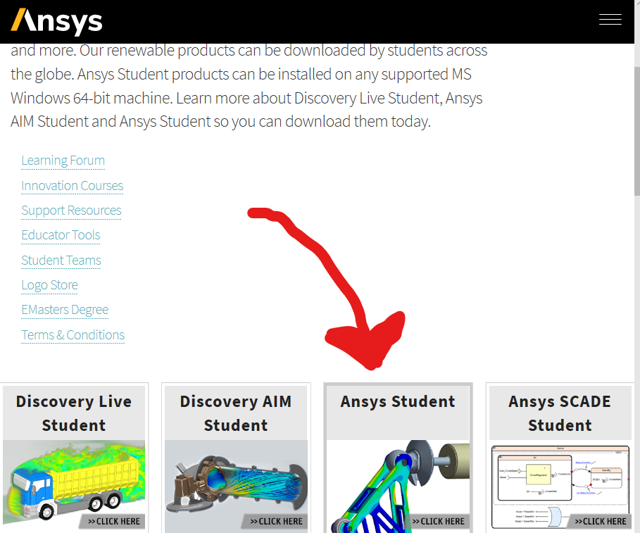
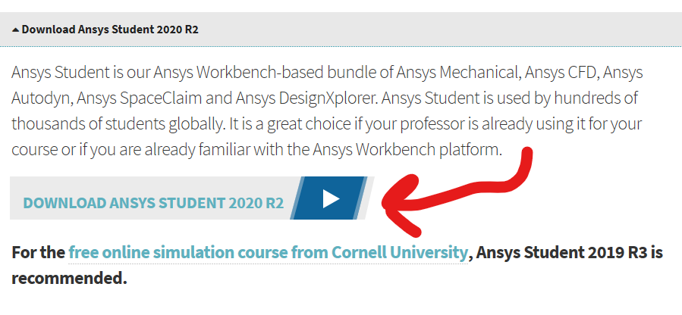
Download and Install Ansys
https://www.ansys.com/academic/free-student-products
Ansys Student 2020 R2.
Not Discover Live Student or Discovery AIM Student.
6.3 GB zipped download file
Unzip
Right click on setup.exe file and run as administrator
Click through install prompts
One optional prompt will report data back to Ansys.
Can go back and delete the installer.
From start menu, search and launch Chemkin 2020 R2.

Slide 6
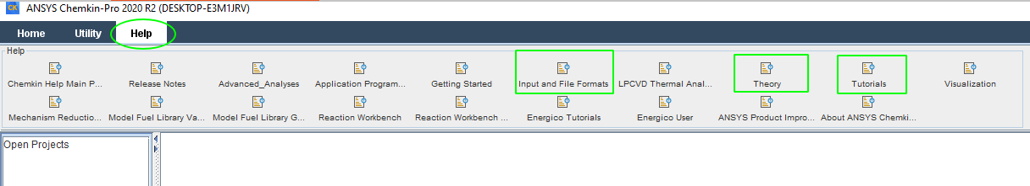
Help and Manuals
Current Manuals accessible in a web-readable version through the software help section.
Ansys controls documents tightly so not downloadable.
Some old versions of manuals in pdf form can be found online.
Input Manual – No longer available
Tutorial Manual - https://personal.ems.psu.edu/~radovic/ChemKinTutorials_PaSR.pdf
Theory Manual – https://personal.ems.psu.edu/~radovic/ChemKin_Theory_PaSR.pdf
Relevant Lennard-Jones parameters- https://pdfs.semanticscholar.org/78ad/3a160b87e2e4e29b6081d2b108e05b0e9cd9.pdf

Slide 7
Alternative Options
Having your own version of Student Chemkin without external license checks will be the simplest way to operate. But if you cannot do this there are other alternatives.
Option 1
Open source alternatives Cantera and RMS are available. To be discussed briefly in the main tutorial.
Option 2
Remote access to Green Group Computers. Currently moving the license server within the group, so is temporarily unavailable. Will be an option in the not too distant future for MIT students.
Option 3
In past years, it has been possible to run ChemkinPro from the Athena Cluster computers and to access them remotely.
As of now I have not been able to verify this access method.
It is not clear whether that license has lapsed or if it is still active.

